Slide 1
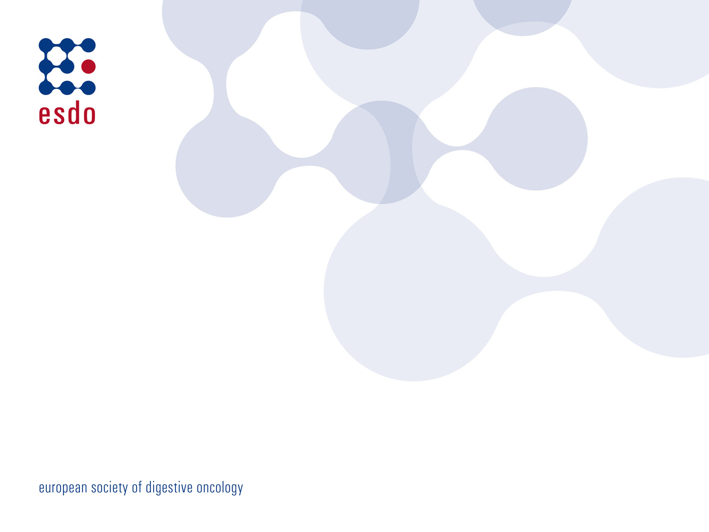
Cholangiocarcinoma Multidisciplinary approach
ESDO Learning Bytes 2022
Yawen Dong
Department of Surgery
HPB Center, Clinic Favoriten
Vienna, Austria

Slide 2
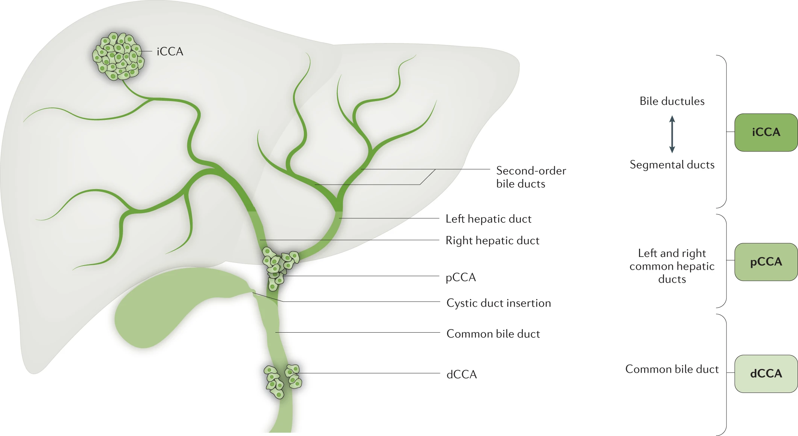
Introduction
Rising incidence of intrahepatic CCA in the past two decades.
extrahepatic

Slide 3
Bismuth-Corlette classification for perihilar CCA
Type I | Tumor below the hepatic confluence
Type II | Tumor has reached the hepatic confluence
Type IIIa | Tumor occluding the common hepatic and right hepatic ducts
Type IIIb | Tumor occluding the common hepatic and left hepatic ducts
Type IV | Tumor that involves the confluence and both the right or left hepatic duct OR tumors that are multicentric

Slide 4
Diagnosis
Cholangiocarcinoma arises from the epithelial cells of the bile ducts
Rare cancer, but highly lethal because most are locally advanced at diagnosis
Typical symptoms: biliary obstruction (jaundice, pruritus), abdominal pain, weight loss, fever, malaise, fatigue,…
Laboratory tests: elevated cholestatic parameters, liver enzymes, tumor markers CEA, CA-19-9, (AFP)
Radiographic findings: abdominal ultrasound (biliary duct dilatation, exclude gallstones), staging CT (distant metastases?), MRCP/ MRI
Distal extrahepatic CCA: intrahepatic + extrahepatic ductal dilation
Perihilar CCA: intrahepatic ductal dilation with normal caliber of extrahepatic ducts
Intrahepatic CCA: mass lesion, usually in a noncirrhotic liver
ERCP (+/- biliary stent implantation) with brush cytology, fine needle aspiration (FNA) – but high risk of ascending cholangitis
CT/US guided biopsy to obtain tissue for histopathological analysis
Cholangioscopy in perihilar CCA allows direct visualization of the biliary duct system and subsequent diagnostic maneuvers (targeted biopsies of lesions)
Multidisciplinary tumor board

Slide 5
Multidisciplinary approach
LFTs, tumor marker, MRCP, MRI ERCP, CT, cholangioscopy etc.
Resectable
Unresectable, metastasized
Discussion points:
* Preoperative biliary drainage?
* Avoid percutaneous biopsy
* Adequate future liver remnant?
* Portal vein embolisation/ hepatic vein occlusion?
* Neoadjuvant therapy?
* Radical surgery possible?
Biopsy
Surgery
Systemic therapy according to ECOG;
Inclusion in clinical trials
Adjuvant therapy

Slide 6
Treatment algorithms
Banales et al. Cholangiocarcinoma: the next horizon in mechanisms and management (2020) Nature Reviews.

Slide 7
Surgery: Future liver remnant (FLR)
Goal: Hypertrophy of the FLR, thus decreasing the risk of post-hepatectomy liver failure (PHLF)
FLR >25% in patients with normal liver function
FLR > 30-40% in patients with preexisting liver injury (steatosis, cirrhosis…)

Slide 8
Surgical approach
Surgical resection as the only potentially curative therapeutic option
Only 25% of CCA patients are resectable at the time of diagnosis
Best case scenario: R0 resection, adequate liver remnant size
3 categories: “clearly resectable”, “clearly unresectable”, “borderline resectable” → individual decision within a HPB center, multidisciplinary discussion!
“Exclusion criteria” for surgery:
Distant metastases
Positive intra-aorto-caval / celiac lymph nodes
Vascular encasement of the portal vein or common hepatic artery >180°
Insufficient FLR for potential radical resection despite intervention to increase FLR (PVE & LVO; ALPPS)

Slide 9
Surgical approach
The localisation of the tumor is essential for the extent of surgical resection:
Intrahepatic
Extent of the liver resection dependent upon size/location of the tumor
Lymphadenectomy
Cholecystectomy
Perihilar
Mostly extended Hemihepatectomy incl. Segment I
En bloc resection of the extrahepatic biliary ducts, CHE
Lymphadenectomy
Biliodigestive anastomosis (hepaticojejunostomy)
Distal
Pylorus-preserving pancreatico-duodenectomy (ppWhipple)

Slide 10
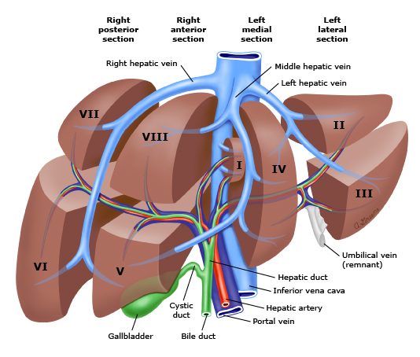
Basic principles of liver resection

Slide 11
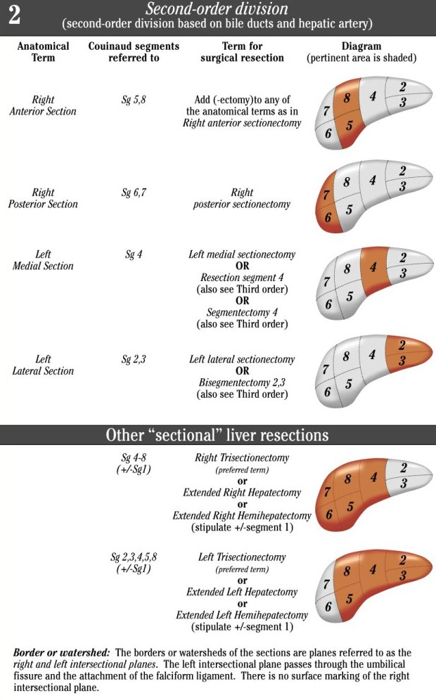
Basic principles of liver resection

Slide 12
Pylorus-preserving pancreaticoduodenectomy (PPPD)
Comparison between the preoperative (left) and postoperative (right) situs:
PPPD as the standard surgical treatment approach in distal CCA:
I. Duodenojejunostomy
II. End-to-side pancreaticojejunostomy
III. Hepaticojejunostomy

Slide 13
Systemic therapy
Neoadjuvant/ conversion/ induction chemotherapy: no consensus, individual decision in borderline resectable cases: gemcitabine + cisplatin (+ nab-paclitaxel)
Adjuvant: standard therapy with capecitabine 1250 mg/m² for 6 months
Locally advanced, unresectable:
Gemcitabine + cisplatin or gemcitabine + oxaliplatin
Poor performance status: monotherapy with gemcitabine, capecitabine or 5-FU
2nd line therapy: FOLFOX

Slide 14
Molecular Profiling
Banales et al. Cholangiocarcinoma: the next horizon in mechanisms and management (2020) Nature Reviews.

Slide 15
Molecular Profiling
IDH1, IDH2 (isocitrate dehydrogenase) – IDH1/IDH2 mutations more common in intrahepatic CCA (~20%)
FGFR2 fusions, rearrangements – also more common in intrahepatic CCA (~15%)
KRAS mutations more frequently observed in perihilar CCA
HER2/neu overexpression – more common in extrahepatic CCA (10-27%)
BRAF V600E mutation – approximately 5% in intrahepatic CCA
MSI (microsatellite instability) - only in about 1% of all CCA subtypes

Slide 16
Targeted therapies & future prospects
FGFR inhibitor: Pemigatinib (FIGHT-202 trial), Infigratinib, Erdafitinib
IDH1 inhibitor: Ivosidenib (ClarIDHy trial)
BRAF inhibitor: Dabrafenib in combination with MEK inhibitor Trametinib (ROAR Basket trial)
Microsatellite instabillity (mismatch repair deficiency): PD-L1 inhibition with checkpoint inhibitor Pembrolizumab (KEYNOTE-158) and in combination with Gemcitabine and Cisplatin (KEYNOTE-966).

Slide 17
Take home messages
Each anatomic subtype (intrahepatic, perihilar, distal) has distinct genetic aberrations, clinical presentations and therapeutic approaches.
Surgery is the only potentially curative treatment option for patients with CCA, however only approx. 25% of CCA patients are resectable at the time of diagnosis.
On the basis of the BILCAP study, capecitabine (6 months) remains the gold standard in the adjuvant setting.
In patients with advanced-stage inoperable CCA, the first-line systemic therapy consists of cisplatin and gemcitabine. FOLFOX has been established as the standard second-line therapy.
Recent advances identifying genetic alterations in CCA highlight the emerging role of precision medicine for this dismal disease.

Slide 18
Thank you for your attention!
Email: yawen.dong@gesundheitsverbund.at

Slide 19
References
Brindley, P.J. et al. Cholangiocarcinoma. Nat Rev Dis Primers 7, 65 (2021). https://doi.org/10.1038/s41572-021-00300-2
Banales, J.M. et al. Cholangiocarcinoma 2020: the next horizon in mechanisms and management. Nat Rev Gastroenterol Hepatol. 2020;17(9):557-588. doi:10.1038/s41575-020-0310-z
Valle, J.W. et al. Biliary cancer: ESMO Clinical Practice Guidelines for diagnosis, treatment and follow-up. Ann Oncol. 2016;27(suppl 5):v28-v37. doi:10.1093/annonc/mdw324
Cillo, U. et al. Surgery for cholangiocarcinoma. Liver Int. 2019;39 Suppl 1(Suppl Suppl 1):143-155. doi:10.1111/liv.14089
Spolverato, G. et al. The Impact of Surgical Margin Status on Long-Term Outcome After Resection for Intrahepatic Cholangiocarcinoma. Ann Surg Oncol. 2015;22(12):4020-4028. doi:10.1245/s10434-015-4472-9
https://www.uptodate.com/contents/treatment-of-localized-cholangiocarcinoma-adjuvant-and-neoadjuvant-therapy-and-prognosis
https://www.ihpba.org/92_Liver-Resection-Guidelines.html

