Slide 1
Why and how to test for germline BRCA mutations in Pancreatic Cancer
ESDO Learning Bytes
December 2021
Alica Katrin Beutel Department of Internal Medicine I, University Hospital Ulm, Germany

Slide 2
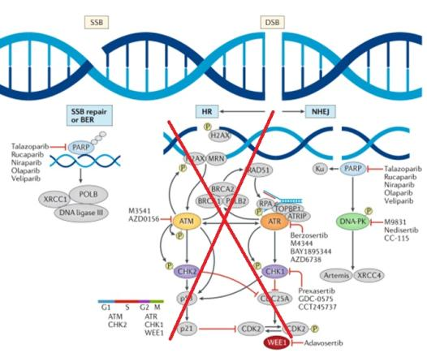
BRCA (BReast CAncer Susceptibility Genes)
BRCA1 and 2
DNA damage repair (DDR) genes
play a crucial role in maintaining genome integrity
involved in the homologous recombination repair (HRR) pathway, an accurate process to repair DNA double-strand breaks (DSBs)
Deleterious gBRCA1/2 mutations
lead to homologous recombination deficiency (HRD)
cells have to rely on non-homologous end joining (NHEJ), an error-prone DNA repair pathway, for repair of DSBs -> causes genomic instability
Pilie et al., Nature Reviews 2019

Slide 3
Deleterious germline BRCA mutations
Carriers of deleterious gBRCA1/2 mutations
Increased life-time risk for cancers
Incidence of gBRCA mutations in PDAC patients
approx. 7.5% (POLO trial, n=3315)
distribution varies regionally (e.g. 12% in Israel, up to 19% in Ashkenazi Jewish ancestries)
most frequent mutation in familial PDAC
Cancer Type | Absolute Risk
 | BRCA1 | BRCA2
Breast | >60% | >60%
Ovarian | 39-58% | 13-29%
Pancreatic | <5% | 5-10%
Golan et al., NJEM 2019
NCCN Guidelines Pancreatic Adenocarcinoma Version 2.2021
NCCN Guidelines Genetic/High Risk Assessment: Breast, Ovarian and Pancreatic Version 1.2022

Slide 4
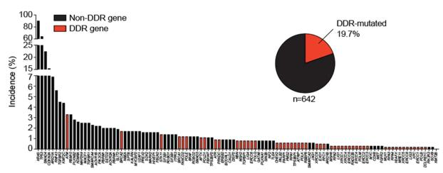
Homologous recombination repair deficiency (HRD) beyond BRCA
- Somatic or germline mutations of DNA damage repair (DDR) genes are found in up to 20% of PDAC patients
- cluster particularly in familial PDAC
Familial PDAC
per definition at least two first-degree relatives affected by PDAC
accounts for up to 10% of all PDAC cases
10-20% of patients have an identifiable germline mutation
most commonly in DDR genes, e.g., BRCA1/2, ATM, PALB2, STK11
mismatch repair genes, e.g., MLH1, MSH2, MSH6, PMS2
classical cancer susceptibility genes, e.g. CDKN2A, TP53
Perkhofer et al., GUT 2021
NCCN Guidelines Pancreatic Adenocarcinoma Version 2.2021
NCCN Guidelines Genetic/High Risk Assessment: Breast, Ovarian and Pancreatic Version 1.2022

Slide 5
Why should we test for germline BRCA mutations?
Immediate treatment implications for patients with gBRCA mutation
1. Platinum-based induction therapy
preferentially FOLFIRINOX or gemcitabine with cisplatin or oxaliplatin
2. Maintenance therapy with olaparib in platinum-sensitive PDAC

Slide 6
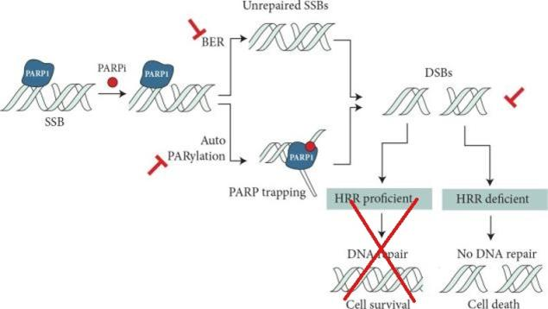
Efficiency of Poly (ADP-ribose) Polymerase (PARP) inhibition and platinum derivates in BRCA mutations
HR-deficient/BRCA mutant cells are particularly sensitive to PARP inhibition and platinum treatment
Platinum derivates:
covalent crosslinking of the DNA induces DSBs
repair of DSBs
SSBs: Single strand breaks
DSBs: Double strand breaks
BER: Base excision repair
HRR: Homologous recombination repair
Modified after Mateo et al., Ann of Oncol 2019

Slide 7
Evidence for efficiency of platinum-based therapy in BRCA mutant PDAC
Lai et al., BJC 2021

Slide 8
Evidence of efficacy of PARP inhibition in gBRCA mutant PDAC
Phase III POLO Trail: Maintenance Olaparib for Germline BRCA-Mutated Metastatic Pancreatic Cancer
Olaparib 300mg bid
(n=92)
- Metastatic PDAC
- Germline BRCA1/2 mutation
- No progression after ≥16 weeks of first-line platinum-based chemotherapy
R
3:2
Placebo
(n=62)
Primary Endpoint:
- Progression-free survival (PFS)
Secondary Endpoints:
- Overall survival (OS)
- ORR
- Safety
Golan et al., NJEM 2019

Slide 9
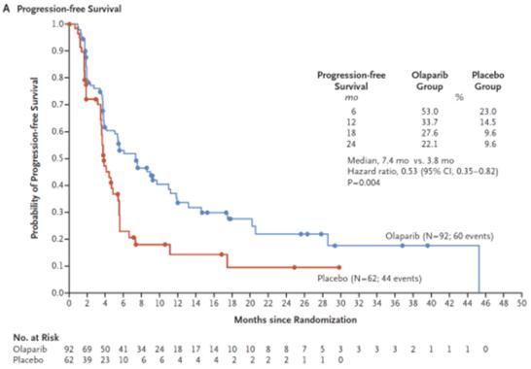
POLO trial: Survival benefit for metastatic PDAC and gBRCA mutation
Survival benefit for patients with metastatic PDAC and gBRCA1 or 2 mutation who had not progressed during first-line platinum-based chemotherapy
significantly longer PFS in olaparib maintenance group vs. placebo (7.4 vs. 3.8 months, HR 0.53, p=0.004)
no difference in OS (18.9 vs. 18.1 months, HR 0.91)
manageable tolerability profile of olaparib
Golan et al., NJEM 2019

Slide 10
Why should we test for germline BRCA mutations?
Immediate treatment implications for patients with gBRCA mutation
1. Platinum-based induction therapy
- preferentially FOLFIRINOX or gemcitabine with cisplatin or oxaliplatin
2. Maintenance therapy with olaparib in platinum-sensitive PDAC
Genetic counseling for patients with gBRCA mutation
1. Consider screening for secondary cancer in PDAC patients in remission
2. Identification of mutation carriers among relatives
- cancer screening and prevention strategies (breast, ovarian and pancreatic cancer)
How should we treat somatic BRCA1/2 mutations or non-BRCA DDR mutations?
Platinum-based therapy, clinical trial

Slide 11
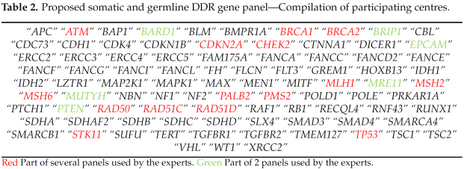
How should we test for germline BRCA mutations?
Who should we test?
all newly diagnosed advanced PDAC patients fit to undergo anti-cancer treatment
How should we test?
Blood sample or tumor tissue sample
Gene panel testing including at a minimum: BRCA1, BRCA2, ATM, MLH1, MSH2, MSH6, EPCA, CDKN21, TP53
or broader testing strategy:
Shindo et al., JCO 2017
ESDO Expert Panel: Perkhofer et al., Cancers 2021
NCCN Guidelines Pancreatic Adenocarcinoma Version 2.2021

Slide 12
Summary: Algorithm for clinical decision making as proposed by the ESDO expert panel
gBRCA mutations in PDAC
Why should we test?
How should we test?
Who should we test?
Perkhofer et al., Cancers 2021

