Slide 1
MANAGEMENT OF FEBRILE NEUTROPAENIA ESDO Learning Bites 2021
Geertrui MERTENS Gastroenterology Dep., AZST Maarten, Mechelen, Belgium
Digestive Oncology Dep., University Hospitals Leuven, Leuven, Belgium

Slide 2
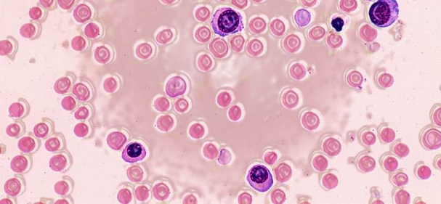
DISCLOSURES
• Consultant/Advisory board: None

Slide 3
MANAGEMENT OF FEBRILE NEUTROPAENIA: CONTENT
DEFINITION
RISK FACTORS
PRIMARY PROPHYLAXIS
MANAGEMENT
TAKE HOME MESSAGES

Slide 4
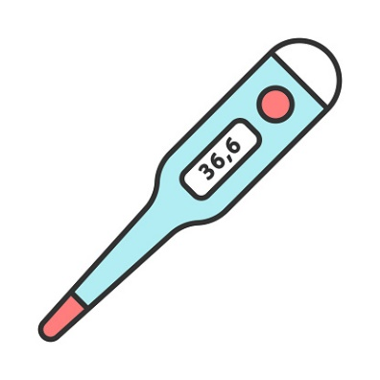
DEFINITION
Fever
Neutropaenia
> 38,3°C
> 38°C for 1 hour
ANC < 0,5 x 109/l
ANC < 1,0 => decline to < 0,5/48h
Febrile neutropaenia
Morbidity - Mortality
Standard dose ChT: ~ 6-8 days of neutropaenia
Morbidity - Mortality
Delays/dose reduction
Hospitalisation
Incidence: ~ 8/1000
~ 20-30% morbidity
~ 10% mortality

Slide 5
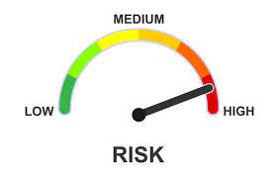
DEFINITION – RISK FACTORS
Fever
Neutropaenia
> 38,3°C
> 38°C for 1 hour
ANC < 0,5 x 109/l
ANC < 1,0 => decline to < 0,5/48h
Febrile neutropaenia
Risk factors
Type of chemotherapy
Age
Advanced disease
History of prior FN
No antibiotic prophylaxis
No granulocyte colony-stimulating factor
Mucositis
Poor performance status
Cardiovascular disease
Comorbidities

Slide 6
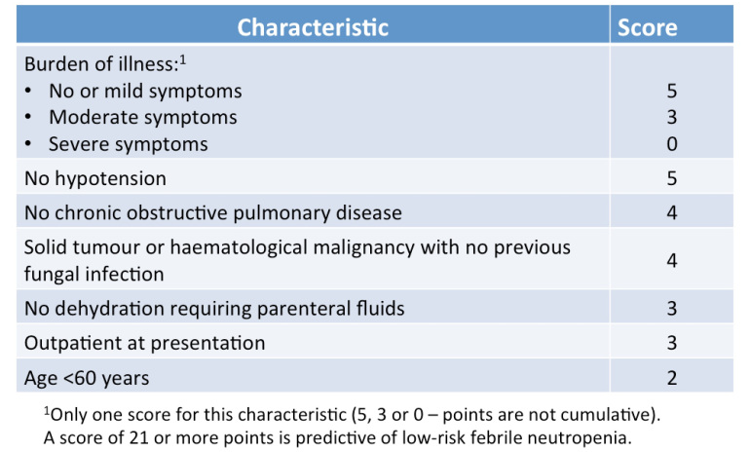
RISK FACTORS
Fever
Neutropaenia
> 38,3°C
> 38°C for 1 hour
ANC < 0,5 x 109/l
ANC < 1,0 => decline to < 0,5/48h
Febrile neutropaenia
MASCC score
Bacteraemia
~ † 18% GN
~ † 5% GP
Prognosis ↓
Focal site infection
High risk < 21
Low risk ≥ 21
< 15: † ~ 40%
≥ 21: † ~ < 5%

Slide 7
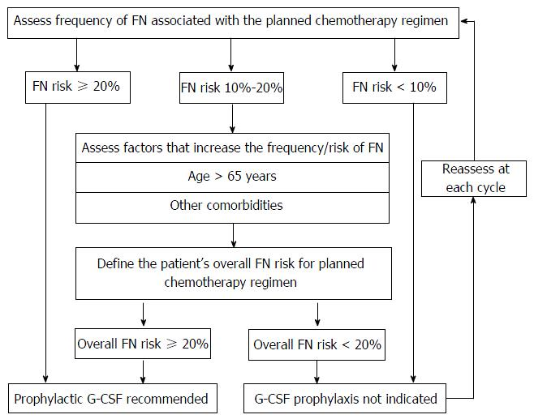
PRIMARY PROPHYLAXIS
Primary prophylaxis > secondary prophylaxis
Curative intent

Slide 8
PRIMARY PROPHYLAXIS
Dose – route of application
G-CSF, Filgastrim:
5µg/kg/day SC
Pegfilgrastim:
100µg/kg single dose SC
6mg single dose SC

Slide 9
MANAGEMENT OF FEBRILE NEUTROPAENIA
Fever
Neutropaenia
> 38,3°C
> 38°C for 1 hour
ANC < 0,5 x 109/l
ANC < 1,0 => decline to < 0,5/48h
Febrile neutropaenia
Medical history
Type ChT
Prior profylactic AB
Steroid use
Past + microbiology?
Physical examination
Routine investigations
Blood testing/HC/UC/SC/SC
RX chest/ultrasound
Early initiation of antibiotica therapy ! < 1h of admission
Assess patient stability
Resuscitate as needed
EDUCATE OUTPATIENTS
ASSESS & RESUSCITATION
MASSC SCORE

Slide 10
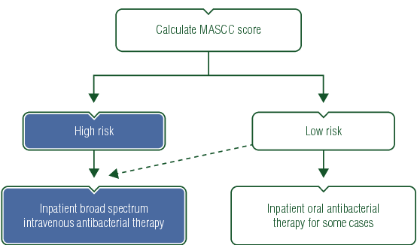
MANAGEMENT OF FEBRILE NEUTROPAENIA
HD stable
No acute leukaemia
No evidence of organ failure
No pneumonia
No VC infection
No soft tissue infection
< 21
≥ 21
+ Vancomycin
+ Antifungal
+ G-CSF:
High risk patient
Severe sepsis

Slide 11
TAKE HOME MESSAGES
1% of patients receiving ChT
Morbidity 20-30%
Mortality 10%
Primary prophylaxis
MASCC score

