Slide 1



MALIGNANT BOWEL OBSTRUCTION
IN ADVANCED STAGE CANCER
ESDO Learning Bytes 2021
Pieter-Jan CUYLE
Gastroenterology Dep., Imelda Hospital, Bonheiden, Belgium
Digestive Oncology Dep., University Hospitals Leuven, Leuven, Belgium

Slide 2
MALIGNANT BOWEL OBSTRUCTION - CONTENT
SCOPE OF THE PROBLEM
DIAGNOSTIC STEPS
DECISION MAKING
MANAGEMENT

Slide 3
MALIGNANT BOWEL OBSTRUCTION - SCOPE OF THE PROBLEM
MBO = bowel obstruction due to cancer or its treatment
3 – 15% of all advanced stage cancers
high incidence in advanced GYN and GI cancers
nausea
vomiting
colic like pain
abdominal distension
lack of flatus/stools
STRANGULATION (bowel ischaemia)
and/or BOWEL PERFORATION
profound effect on QUALITY of LIFE
MALNUTRITION with cachexia/sarcopenia
DIFFICULT MANAGEMENT IN ADVANCED STAGE CANCER
< deteriorating mobility/function (performance status)
< lack of further anti-cancer treatment options
< high morbidity/mortality of palliative surgery
< lack of high level scientific guidance/evidence
Huang X., et al. Ann Pharmacother 2020

Slide 4
MALIGNANT BOWEL OBSTRUCTION - DIAGNOSTIC STEPS
MBO = contrast enhanced CT scan of abdomen and pelvis
1. LOCATION
small bowel (61%) – large bowel (33%) – both (>20%)
2. CAUSE
CANCER RELATED
1/ EXTRINSIC bowel compression < malignant mass or adhesions
2/ ENDOLUMINAL obstruction < polyp or GI tumor
< radiotherapy induced fibrosis
3/ FUNCTIONAL obstruction < enteric nerve plexus invasion
< drug induced
< paraneoplastic
NON-CANCER RELATED
e.g. incarcerated inguinal hernia
3. PARTIAL or COMPLETE
4. UNILEVEL or MULTILEVEL
5. ISCHAEMIA or PERFORATION
Ferguson H., et al. Ann Med Surg (Lond.) 2015

Slide 5
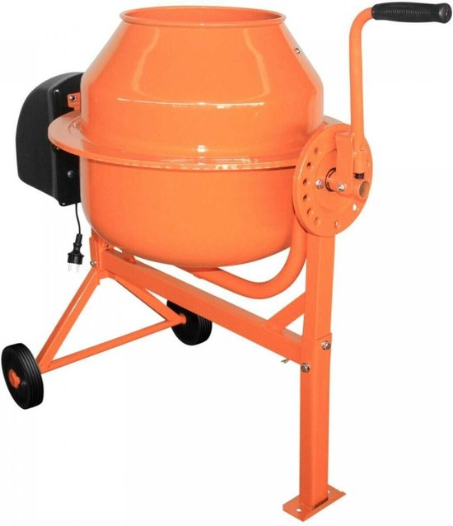
MALIGNANT BOWEL OBSTRUCTION - DECISION MAKING
MBO decision making = MULTIDISCIPLINARY TEAM
OBSTRUCTION RELATED factors
CANCER RELATED factors
1. LOCATION
2. CAUSE
3. PARTIAL or COMPLETE
4. UNILEVEL or MULTILEVEL
5. ISCHAEMIA or PERFORATION
1. MALIGNANT DISEASE EXTENSION
2. GENERAL PROGNOSIS
3. REMAINING TREATMENT OPTIONS
1. PATIENT CHARACTERISTICS
(age, comorbidity, performance status)
2. PATIENT PREFERENCE
PATIENT RELATED factors
(experienced)
abdominal surgery
oncology
gastroenterology/endoscopy
radiology
radiotherapy
palliative care specialist
TREATMENT GOAL
MDT

Slide 6
MALIGNANT BOWEL OBSTRUCTION - MANAGEMENT
MBO management = low level scientific evidence
INITIAL RESUSCIATIVE MEASURES
nihil per os
fluid and electrolyte replacement
DIAGNOSTIC CT SCAN
MDT
decision making
NON-SURGICAL CANDIDATE (inoperable)
MEDICAL MANAGEMENT
SURGICAL CANDIDATE
SURGICAL MANAGEMENT
bowel resection and anastomosis
diverting stoma placement (ileostomy to be avoided)
internal bypass surgery
TIMING
TYPE

Slide 7
MALIGNANT BOWEL OBSTRUCTION – MEDICAL MANAGEMENT
NON-SURGICAL CANDIDATE (inoperable)
MEDICAL MANAGEMENT
1. BOWEL DECOMPRESSION
acute: nasogastric (-intestinal) suction tube
chronic: percutaneous ‘venting’ gastrostomy
Thampy S., et al. J Palliat Care 2020
2. PHARMACOLOGICAL
ANTI-EMETICS
cave use of prokinetics in complete obstruction
ANTI-SECRETORY
PPI, anticholinergics, H2-blocker, somatostatine analogue
ANTI-INFLAMMATORY
corticosteroids
ANALGETICS
ANTIBIOTICS
cave translocation in immunosuppressed patients
Review article – Medical management of inoperable malignant bowel obstruction – Huang X., et al.
Ann Pharmacother 2020
3. NUTRITIONAL SUPPORT
4. THERAPEUTIC ENDOSCOPY

Slide 8
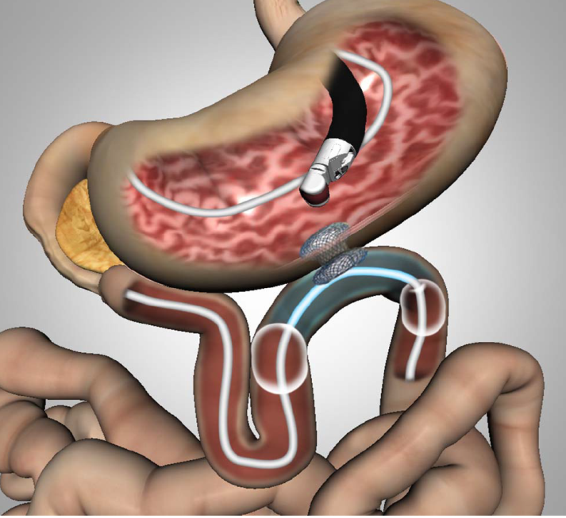
MALIGNANT BOWEL OBSTRUCTION – MEDICAL MANAGEMENT
NON-SURGICAL CANDIDATE (inoperable)
MEDICAL MANAGEMENT
4. THERAPEUTIC ENDOSCOPY
for lesions “within reach” of the endoscope (except distal rectum)
SELF-EXPANDABLE METAL STENT (SEMS)
1. reinstitution of natural luminal passage
2. endoscopic bypass procedure
uncovered
partially covered
fully covered stents
stent re-occlusion
stent migration
perforation
(cave. use anti-VEGF targeted agents)
Itoi T., et al. Gut 2015
Braga Ribeiro I., et al. World J Gastrointest Endosc 2019
AGA clinical practice guidelines. Ahmed O. et al. Clin Gastroenterol Hepatol 2021

Slide 9
MALIGNANT BOWEL OBSTRUCTION – TAKE HOME MESSAGES
MBO is prevalent in advanced stage cancer and is associated with profound impact on QoL and prognosis of patients.
Contrast enhanced CT of abdomen and pelvis remains the gold standard in diagnostic and therapeutic assessment of MBO.
Therapeutic decision making in MBO is often difficult and needs to be undertaken in the context of an experienced multidisciplinary team.

