Slide 1
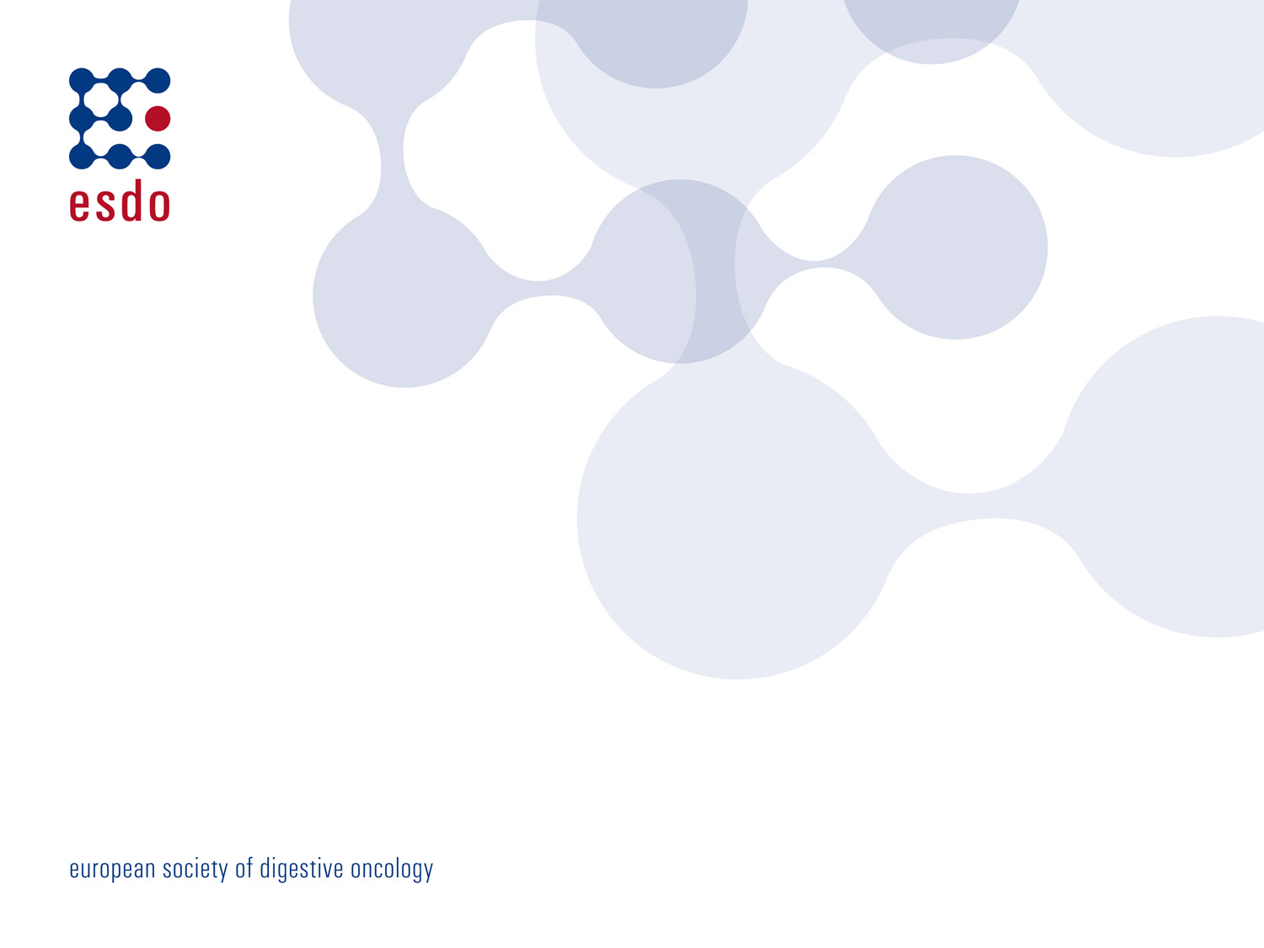
Anti-EGFR induced skin toxicity
ESDO Learning Bytes 2021
Dr Violaine RANDRIAN
Department of Gastroenterology, Poitiers University Hospital, France

Slide 2
DISCLOSURES
AMGEN
MERCK
PHARMAFIELD
BAYER

Slide 3
Anti-EGFR in Gastroenterology
COLORECTAL CANCER (CRC)
Anti-EGFR + chemotherapy = first line treatment in metastatic setting
with Wild Type KRAS cancer = 50% of patients with mCRC
In Europe
520 000 cases
240 000 deaths
Globocan 2020: Global Cancer Observatory: https://gco.iarc.fr/
Van Cutsem E, Cervantes A, Adam R, et al. ESMO consensus guidelines for the management of patients with metastatic colorectal cancer. Ann Oncol 2016 ;27(8):1386-422.
Lièvre A, Bachet JB, Le Corre D, et al. KRAS mutation status is predictive of response to cetuximab therapy in colorectal cancer. Cancer Res 2006 66(8):3992-5.
Modest DP, Martens UM, Riera-Knorrenschild J, et al. FOLFOXIRI Plus Panitumumab As First-Line Treatment of RAS Wild-Type Metastatic Colorectal Cancer: The Randomized, Open-Label, Phase II VOLFI Study (AIO KRK0109). J Clin Oncol 2019 ;37(35):3401-3411

Slide 4
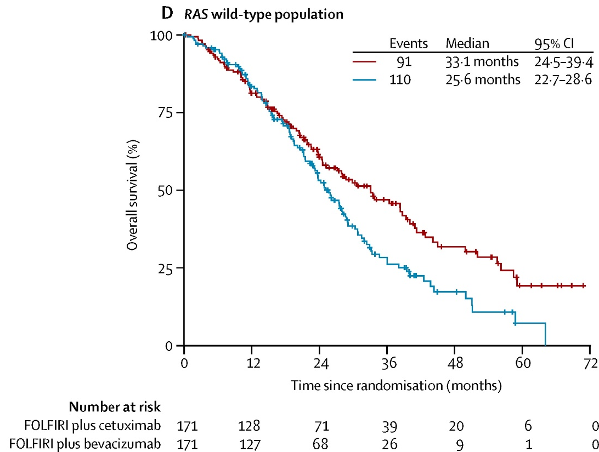
Anti-EGFR in Gastroenterology: CETUXIMAB & PANITUMUMAB
Anti-EGFR + chemotherapy = first line treatment in metastatic setting
with Wild Type KRAS cancer = 50% of patients with mCRC
Prolonged overall survival
+/- 8months
Heinemann V, von Weikersthal LF, Decker T, et al. FOLFIRI plus cetuximab versus FOLFIRI plus bevacizumab as first-line treatment for patients with metastatic colorectal cancer (FIRE-3): a randomised, open-label, phase 3 trial. Lancet Oncol. 2014;15(10):1065-1075. Modest DP, Martens UM, Riera-Knorrenschild J, et al. FOLFOXIRI Plus Panitumumab As First-Line Treatment of RAS Wild-Type Metastatic Colorectal Cancer: The Randomized, Open-Label, Phase II VOLFI Study (AIO KRK0109). J Clin Oncol 2019 ;37(35):3401-3411

Slide 5
Anti-EGFR in Gastroenterology: CETUXIMAB & PANITUMUMAB
Anti-EGFR + chemotherapy = first line treatment in metastatic setting
with Wild Type KRAS cancer = 50% of patients with mCRC
Prolonged overall survival
+/- 8months
Monitoring side effects
To maintain treatment
To maintain Quality Of Life
Heinemann V, von Weikersthal LF, Decker T, et al. FOLFIRI plus cetuximab versus FOLFIRI plus bevacizumab as first-line treatment for patients with metastatic colorectal cancer (FIRE-3): a randomised, open-label, phase 3 trial. Lancet Oncol. 2014;15(10):1065-1075. Modest DP, Martens UM, Riera-Knorrenschild J, et al. FOLFOXIRI Plus Panitumumab As First-Line Treatment of RAS Wild-Type Metastatic Colorectal Cancer: The Randomized, Open-Label, Phase II VOLFI Study (AIO KRK0109). J Clin Oncol 2019 ;37(35):3401-3411

Slide 6
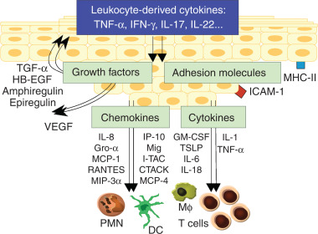
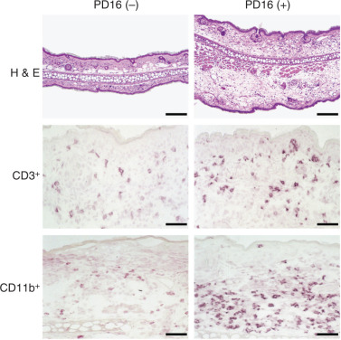
MONITORING ANTI-EGFR SKIN TOXICITY = MONITORING SKIN INFLAMMATION
No anti-EGFR
with anti-EGFR
Pastore S, Mascia F, Mariani V, Girolomoni G. The epidermal growth factor receptor system in skin repair and inflammation. J Invest Dermatol. 2008;128(6):1365-1374
Tougeron D, Emambux S, Favot L, et al. Skin inflammatory response and efficacy of anti-epidermal growth factor receptor therapy in metastatic colorectal cancer (CUTACETUX). Oncoimmunology. 2020;9(1):1848058.

Slide 7
Monitoring Anti-EGFR skin toxicity: Paronychia
10-15% of patients
2-3% of patients
antibacterial emollient
chloramine baths
Lacouture ME, Anadkat M, Jatoi A, Garawin T, Bohac C, Mitchell E. Dermatologic Toxicity Occurring During Anti-EGFR Monoclonal Inhibitor Therapy in Patients With Metastatic Colorectal Cancer: A Systematic Review. Clin Colorectal Cancer. 2018;17(2):85-96.

Slide 8
Monitoring Anti-EGFR skin toxicity: Acneiform rash
60-90% of patients under anti-EGFR
after 1 or 2 infusions
Lacouture ME, Sibaud V, Gerber PA, et al. Prevention and management of dermatological toxicities related to anticancer agents: ESMO Clinical Practice Guidelines☆. Ann Oncol. 2021;32(2):157-170.
Segaert S, Van Cutsem E. Clinical signs, pathophysiology and management of skin toxicity during therapy with epidermal growth factor receptor inhibitors. Ann Oncol 2005; 16: 1425-1433

Slide 9
Monitoring Anti-EGFR skin toxicity: Acneiform rash
60-90% of patients under anti-EGFR
after 1 or 2 infusions
Grade 1-2
Papules and/or pustules
cover 10%-30% Body Surface Area
+Pruritus
+Tenderness
Lacouture ME, Sibaud V, Gerber PA, et al. Prevention and management of dermatological toxicities related to anticancer agents: ESMO Clinical Practice Guidelines☆. Ann Oncol. 2021;32(2):157-170.
Segaert S, Van Cutsem E. Clinical signs, pathophysiology and management of skin toxicity during therapy with epidermal growth factor receptor inhibitors. Ann Oncol 2005; 16: 1425-1433

Slide 10
Monitoring Anti-EGFR skin toxicity: Acneiform rash
70 to 100% of patients under anti-EGFR
after 1 or 2 infusions
Grade 1-2
Papules and/or pustules
cover 10%-30% Body Surface Area
+Pruritus
+Tenderness
Grade 3
Papules and/or pustules
cover > 30% Body Surface Area
+Pruritus
+Tenderness
+ Local Surinfection
Lacouture ME, Sibaud V, Gerber PA, et al. Prevention and management of dermatological toxicities related to anticancer agents: ESMO Clinical Practice Guidelines☆. Ann Oncol. 2021;32(2):157-170.
Segaert S, Van Cutsem E. Clinical signs, pathophysiology and management of skin toxicity during therapy with epidermal growth factor receptor inhibitors. Ann Oncol 2005; 16: 1425-1433

Slide 11
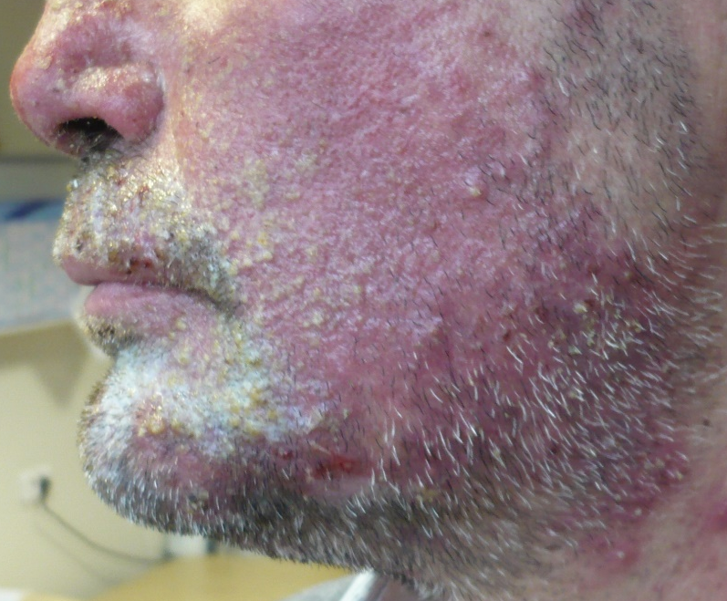
ACNEIFORM RASH = main skin Anti-EGFR Toxicity
Maculo-papular exanthema
Local surinfection
Impact on Quality Of Life

Slide 12
Monitoring anti-EGFR-induced skin toxicity: Acneiform Rash
PREVENTION
Oral antibiotics from start of therapy
Doxycycline or Minocycline
Moisturising cream twice daily
Avoid skin irritants
Avoid sun exposure
Lacouture ME, Sibaud V, Gerber PA, et al. Prevention and management of dermatological toxicities related to anticancer agents: ESMO Clinical Practice Guidelines☆. Ann Oncol. 2021;32(2):157-170.

Slide 13
Monitoring anti-EGFR-induced skin toxicity: Acneiform Rash
PREVENTION
Oral antibiotics from start of therapy
Doxycycline or Minocycline
Moisturising cream twice daily
Avoid skin irritants
Avoid sun exposure
TREATMENT
Grade 1-2
10%-30% BSA
Dose adaptation
Oral antibiotic
Topical steroid
Follow-up every two weeks
Lacouture ME, Sibaud V, Gerber PA, et al. Prevention and management of dermatological toxicities related to anticancer agents: ESMO Clinical Practice Guidelines☆. Ann Oncol. 2021;32(2):157-170.

Slide 14
Monitoring anti-EGFR-induced skin toxicity: Acneiform Rash
PREVENTION
Oral antibiotics from start of therapy
Doxycycline or Minocycline
Moisturising cream twice daily
Avoid skin irritants
Avoid sun exposure
TREATMENT
Grade 1-2
10%-30% BSA
Dose adaptation
Oral antibiotic
Topical steroid
Grade 3
>30% BSA
STOP anti-EGFR
Oral +/- Local antibiotic
Topical steroid
Systemic corticosteroids 0,5-1mg/kg - 7days
Follow-up every two weeks
Resolution within one month after anti-EGFR discontinuation
Lacouture ME, Sibaud V, Gerber PA, et al. Prevention and management of dermatological toxicities related to anticancer agents: ESMO Clinical Practice Guidelines☆. Ann Oncol. 2021;32(2):157-170.

Slide 15
Monitoring anti-EGFR-induced skin toxicity
TREAT
Locally
Systemically
Reassess
Adapt anti-EGFR treatment
ADDRESS
Dermatology
department
PREVENT
Locally
Systemically
Lacouture ME, Sibaud V, Gerber PA, et al. Prevention and management of dermatological toxicities related to anticancer agents: ESMO Clinical Practice Guidelines☆. Ann Oncol. 2021;32(2):157-170.

