Slide 1

Prevention and management of
chemotherapy-induced nausea and vomiting
ESDO Learning Bytes 2021
Dr. Alica Katrin Beutel Department of Internal Medicine I
University Hospital Ulm, Germany

Slide 2
SCOPE OF THE PROBLEM
Chemotherapy-induced nausea and vomiting (CINV)
decline of performance status
dehydration
metabolic imbalance
anticancer agents
emesis
malnutrition with cachexia/sarcopenia
radiation
vomiting
decreased quality of life
eosophageal tears
withdrawal from therapy

Slide 3
DIAGNOSTIC STEPS – Frequency and severity of nausea and vomiting
Anticancer agents
emetic risk of the substance
dosage
administration schedule
Patient risk factors
young age
female sex
previous history of anticancer agent-induced nausea
little or no previous alcohol use
prone to motion sickness
history of morning sickness during pregnancy
anxiety
high pretreatment expectation of nausea
CTCAE v5.0
Adverse event | Grade 1 | Grade 2 | Grade 3 | Grade 4 | Grade 5
Nausea | Loss of appetite without alteration in eating habits | Oral intake decreased without significant weight loss, dehydration or malnutrition | Inadequate oral caloric or fluid intake; tube feedings, TPN, or hospitalization indicated
Vomiting | Intervention not indicated | Outpatient intravenous hydration, medical intervention indicated | Tube feeding, TPN, or hospitalization indicated | Life-threatening consequences | death
Adapted from: Common Terminology Criteria for Adverse Events (CTCAE), Version 5.0, November 2017, National Institutes of Health, National Cancer Institute. Available at: https://ctep.cancer.gov/protocoldevelopment/electronic_applications/docs/CTCAE_v5_Quick_Reference_8.5x11.pdf
NCCN: National Comprehensive Cancer Network; NCCN Clinical Practice Guidelines in Oncology; Antiemesis Version 1.2021. Available at: www.nccn.org

Slide 4
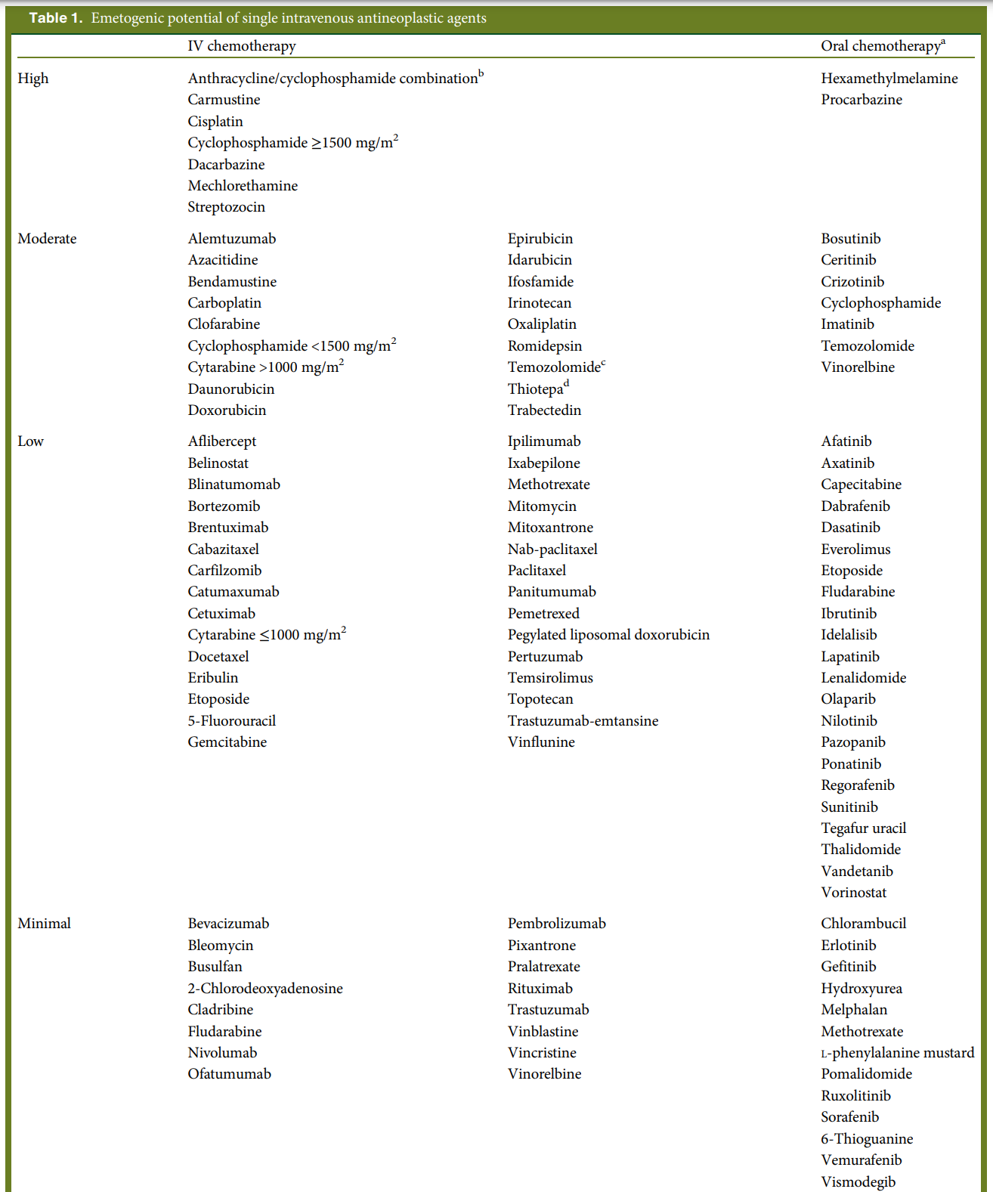
DIAGNOSTIC STEPS – Emetogenicity of anticancer agents
Antiemetic risk group
Emetic risk group | % of patients
High emetic risk | 90% or more experience acute emesis
Moderate emetic risk | 30 to 90% experience acute emesis
Low emetic risk | 10 to 30% experience acute emesis
Minimal emetic risk | 10% or less experience acute emesis
NCCN: National Comprehensive Cancer Network; NCCN Clinical Practice Guidelines in Oncology; Antiemesis Version 1.2021.
MASCC AND ESMO CONSENSUS GUIDELINES, Ann Oncol (2016)

Slide 5
DIAGNOSTIC STEPS – Types of CINVs
Classification | Definition
Acute CINV | usually occurs within minutes to several hours after administration of anticancer agents and usually resolves within 24 hours
Delayed CINV | develops more than 24 hours after administration
Anticipatory CINV | occurs before patients receive their next treatment, conditioned response after previous negative experience
Breakthrough CINV | occurs despite prophylactic treatment, requires rescue antiemetics
Refractory CINV | prophylactic and rescue treatment not effective
NCCN: National Comprehensive Cancer Network; NCCN Clinical Practice Guidelines in Oncology; Antiemesis Version 1.2021. Available at: www.nccn.org

Slide 6
DIAGNOSTIC STEPS – Other potential causes of emesis in cancer patients
partial or complete bowel obstruction
gastroparesis: tumor/chemotherapy-induced or other causes (e.g. diabetes)
brain metastases
electrolyte imbalance: hypercalcemia, hyperglycemia, or hyponatremia
uremia
concomitant drug treatments, including opioids
malignant ascites
anxiety
anticipatory nausea/vomiting
rapid opioid withdrawal, cannabinoid hyperemesis syndrome
vestibular dysfunction
pancreatitis
NCCN: National Comprehensive Cancer Network; NCCN Clinical Practice Guidelines in Oncology; Antiemesis Version 1.2021. Available at: www.nccn.org

Slide 7
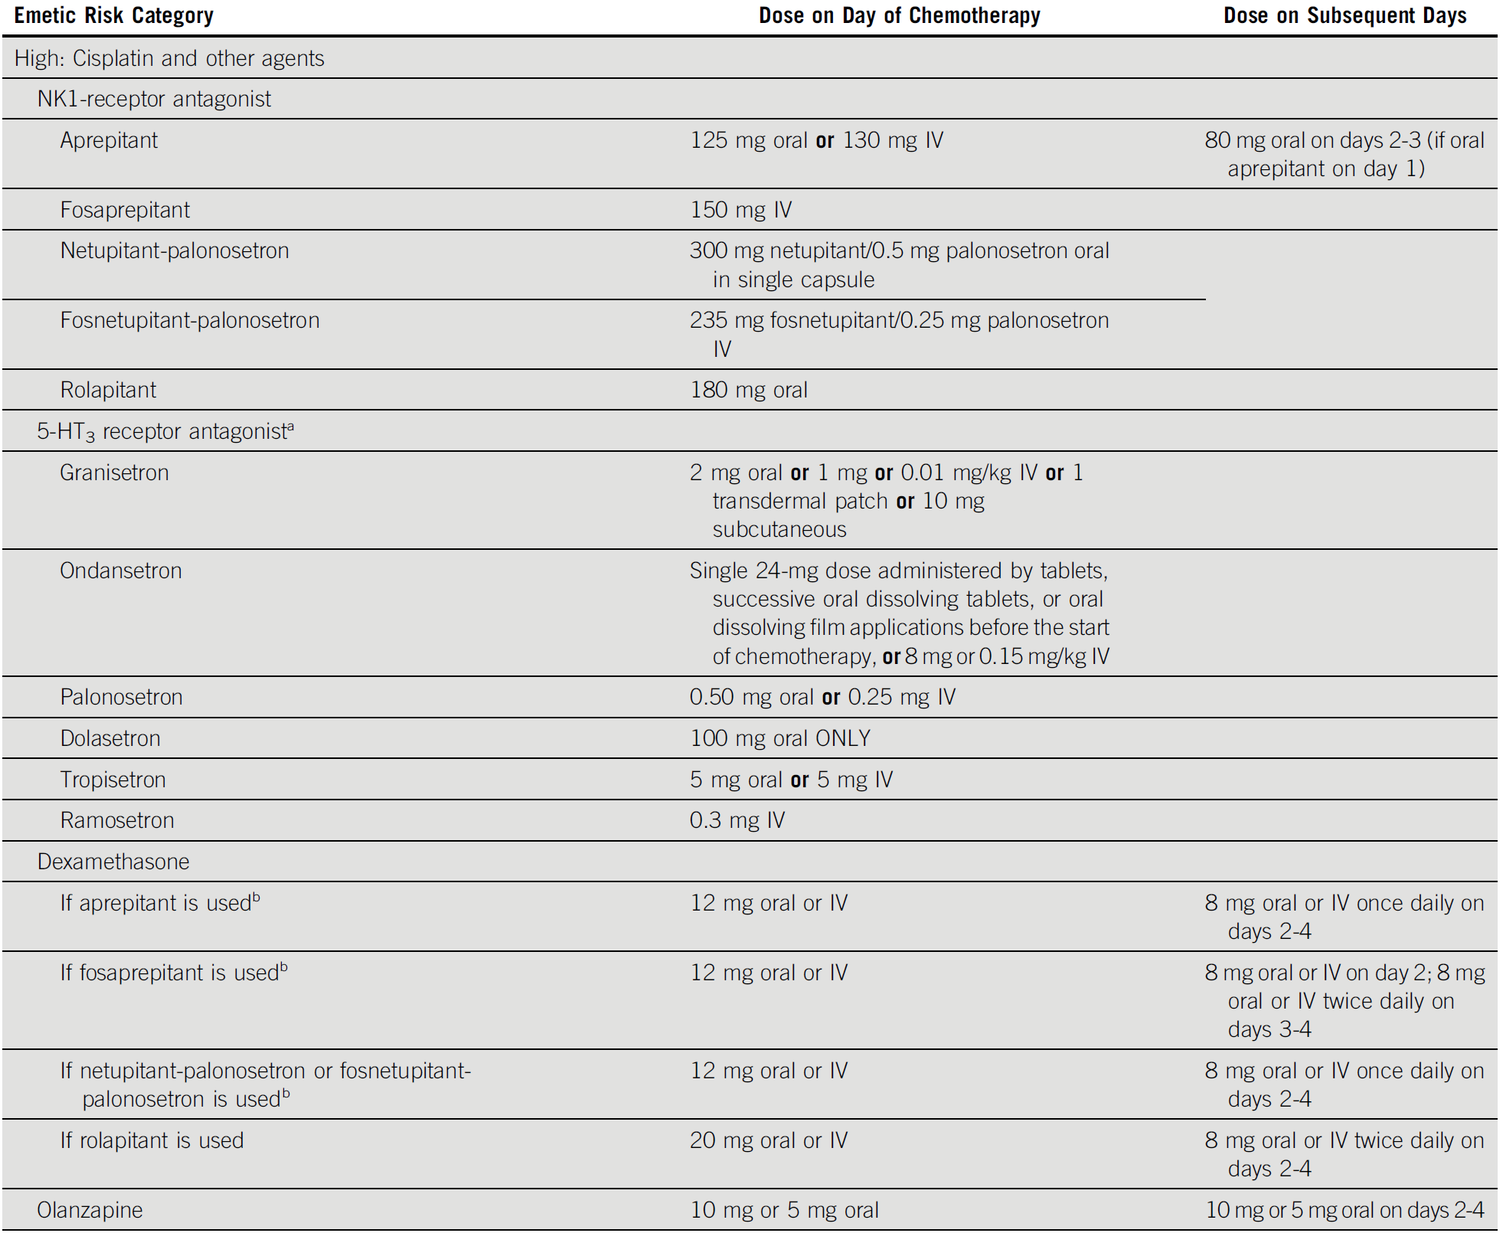
PREVENTION AND MANAGEMENT – Acute and delayed antiemetic prevention
Antiemetics: ASCO Guideline Update. Journal of Clinical Oncology 2020

Slide 8
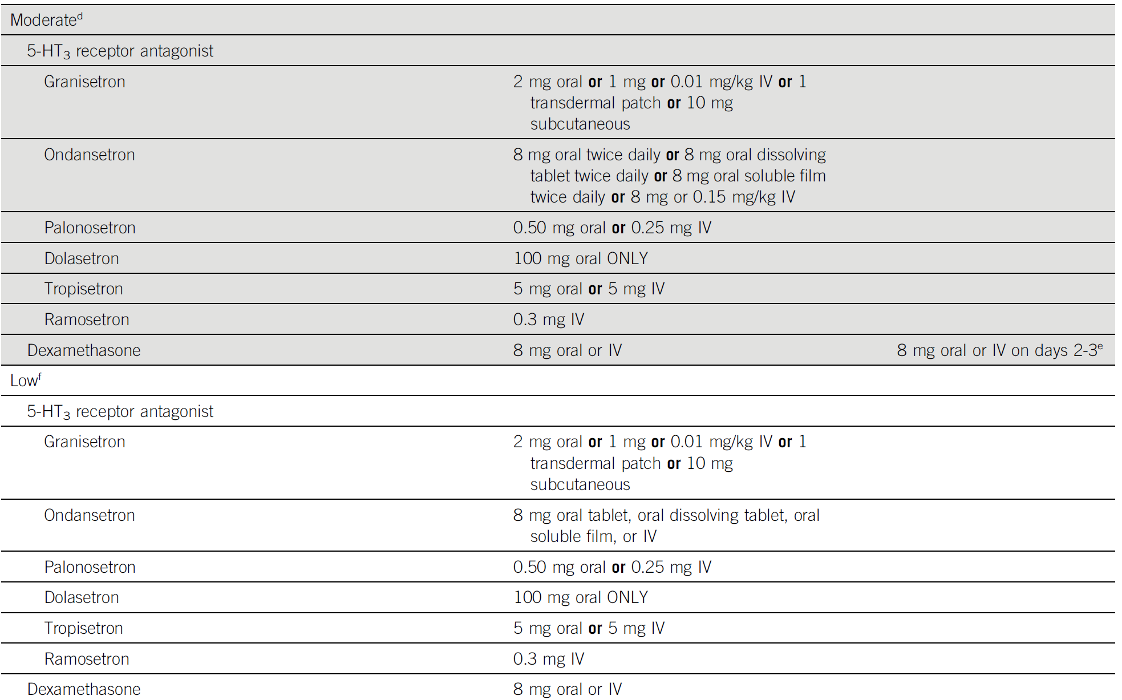
PREVENTION AND MANAGEMENT – Acute and delayed antiemetic prevention
Antiemetics: ASCO Guideline Update. Journal of Clinical Oncology 2020

